Slide 1
Eigenvalues and Eigenvectors
Vector Spaces
Bumhee Cho

Slide 2
ℝ¹
ℝ²
⋯
ℝ^{n}
part of vector spaces!!

Slide 3
Vector Space
A vector space is a nonempty set V of objects, called vectors, on which are defined two operations, called addition and multiplication by scalars, subject to the ten axioms listed below. The axioms must hold for all vectors u, v, and w in V and for all scalars c and d
1. The sum of u and v, denoted by u + v, is in V
2. u + v = v + u
3. (u + v) + w = (w + v) + u
4. There is a zero vector 0 in V such that u + 0 = u
5. For each u in V, there is a vector -u in V such that u + (-u) = 0
6. The scalar multiple of u by c, denoted by cu, is in V
7. c(u + v) = cu + cv
0u = 0
c0 = 0
-u = (-1)u
8. (c + d)u = cu + du
9. c(du) = (cd)u
10. 1u = u

Slide 4
Polynomial Space
For n ≥ 0, the set ℙ_{n} of polynomials of degree at most n consists of all polynomials of the form
p(t) = a₀ + a₁t + a₂t ² + ⋯ + a_{n}t ^{n}
ℙ_{n} is a vector space !

Slide 5
Subspace
A subspace of a vector space V is a subset H of V that has three properties:
a. The zero vector of V is in H
b. H is closed under vector addition. That is, for each u and v in H, the sum u + v is in H
c. H is closed under multiplication by scalars. That is, for each u in H and each scalar c, the vector cu is in H

Slide 6
Linear Transformation
A linear transformation T from a vector space V into a vector space W is a rule that assigns to each vector x in V a unique vector T(x) in W, such that
1. T(u + v) = T(u) + T(v)
2. T(cu) = cT(u)

Slide 7
Linear Dependency
An indexed set of vectors {v₁,… , v_{p}} in V is said to be linearly independent
if the vector equation
c₁v₁ + c₂v₂ + ⋯ + c_{p}v_{p} = 0
has only the trivial solution

Slide 8

Basis
Let H be a subspace of a vector space V. An indexed set of vectors B = {b₁,… , b_{p}} in V is a basis for H if
1. B is a linearly independent set, and
2. the subspace spanned by B coincides with H; that is,
H = Span {b₁,… , b_{p}}

Slide 9
Example 1
Let S = {1, t, t ², … t^{n}}. Verify that S is a basis for ℙ_{n}. this basis is called the standard basis for ℙ_{n}
S spans ℙ_{n}
c₀⋅1 + c₁t + ⋯ + c_{n}t ^{n} = 0(t)

Slide 10
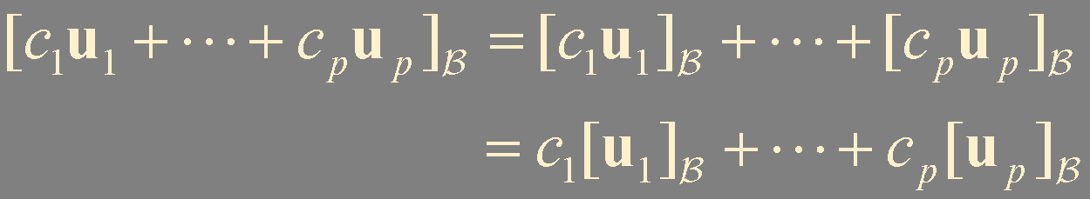
Theorem
Let B = {b₁,… , b_{n}} be a basis for a vector space V. Then the coordinate mapping x ↦ [x]_{B} is a one-to-one linear transformation from V onto ℝ^{n}
x ↦ [x] is isomorphism from V onto ℝ^{n}
B-coordinate vector of a linear combination of u₁,… , u_{p} is the same linear combination of their coordinate vectors

Slide 11
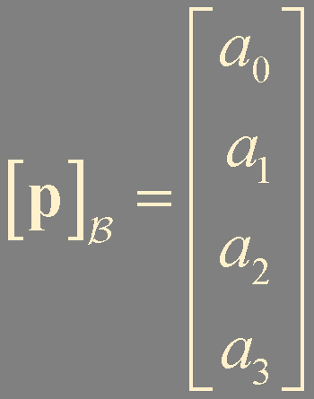
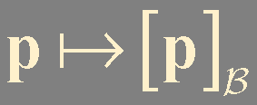
Let B be the standard basis of the space ℙ₃ of polynomials; that is, let B = {1, t, t ², t³}.
A typical element p of ℙ₃ has the form
p(t) = a₀ + a₁t + a₂t ² + a₃t ³
is isomorphism from ℙ₃ onto ℝ⁴

Slide 12
Summary
Vector space
Polynomial space

